Slide 1
Diploma demo
May 10 s20431

Slide 2

Subject
“Data suggestion tool in the digital age using web application to optimize work time on example of geo-data”

Slide 3
Business case
I decided to write an application supporting the employee with suggestive data on localization topics. As an employee of the development company XYZ, I have experienced exhaustive work with selective customer-supplied data collected by competitors. They were selective because the competition did not require the collection of specific data that was necessary to enter into the system in the company for which the application is dedicated. The job was to search the Internet for information that was missing, such as: address, zip code, city, latitude and longitude.

Slide 4

Scope
Result of this work is to optimize the time spent on searching for individual information through a script that searches for this information for us in a much shorter time.

Slide 5

Assumptions
Theoretical assumptions are the existence of some data in order to find more on their basis. To find a given location, you need the following data sets:
facility name and address,
name of the facility and city,
property name and zip code,
address and city,
address and postal code,
latitude and longitude,
tax identification number (optional)

Slide 6

Environment issue
The problem that this job aims to solve is time management and its optimization in the work environment on a specific business example.

Slide 7

Data
Data quality tests obtained by this application will be carried out on generally available data on the Internet. Specially prepared data with missing elements will be passed through the application, and then the quality test of this data will be carried out based on the completed list of initial data and the proposals presented by the applications. On this basis, the percentage probability of the quality of data presented by this application will be calculated.

Slide 8
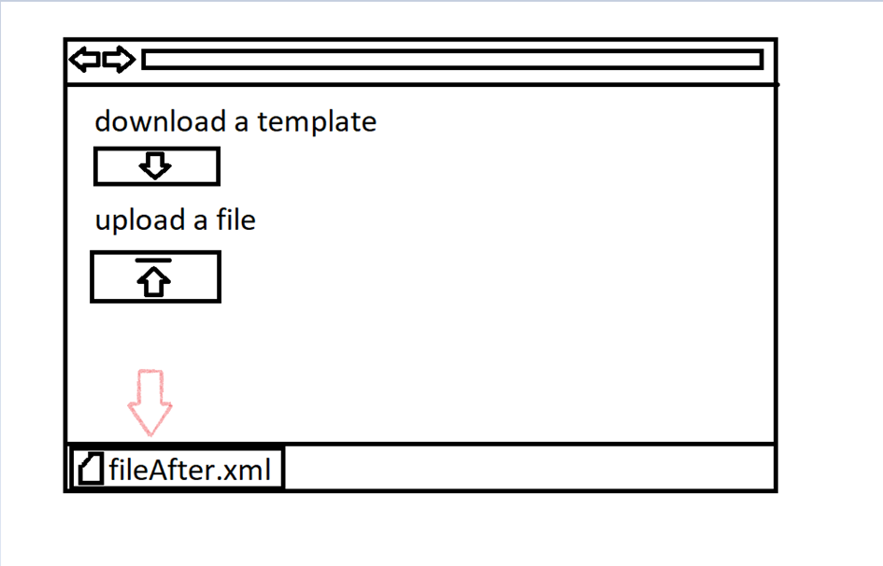
Graphical idea prototype

Slide 9
Demo

